Slide 1
Autonomous Supervision for Ships with Temporarily Unmanned Bridge
Peter Nicholas Hansen, PhD Candidate
Technical University of Denmark, Dept. of Electrical Engineering, Automation and Control Group, DK 2800 Lyngby, Denmark
CCAS conference "Frontiers in Autonomous Systems"
November 24th and 25th of November 2021 - OTICON Salen, DTU Lyngby Campus.

Slide 2
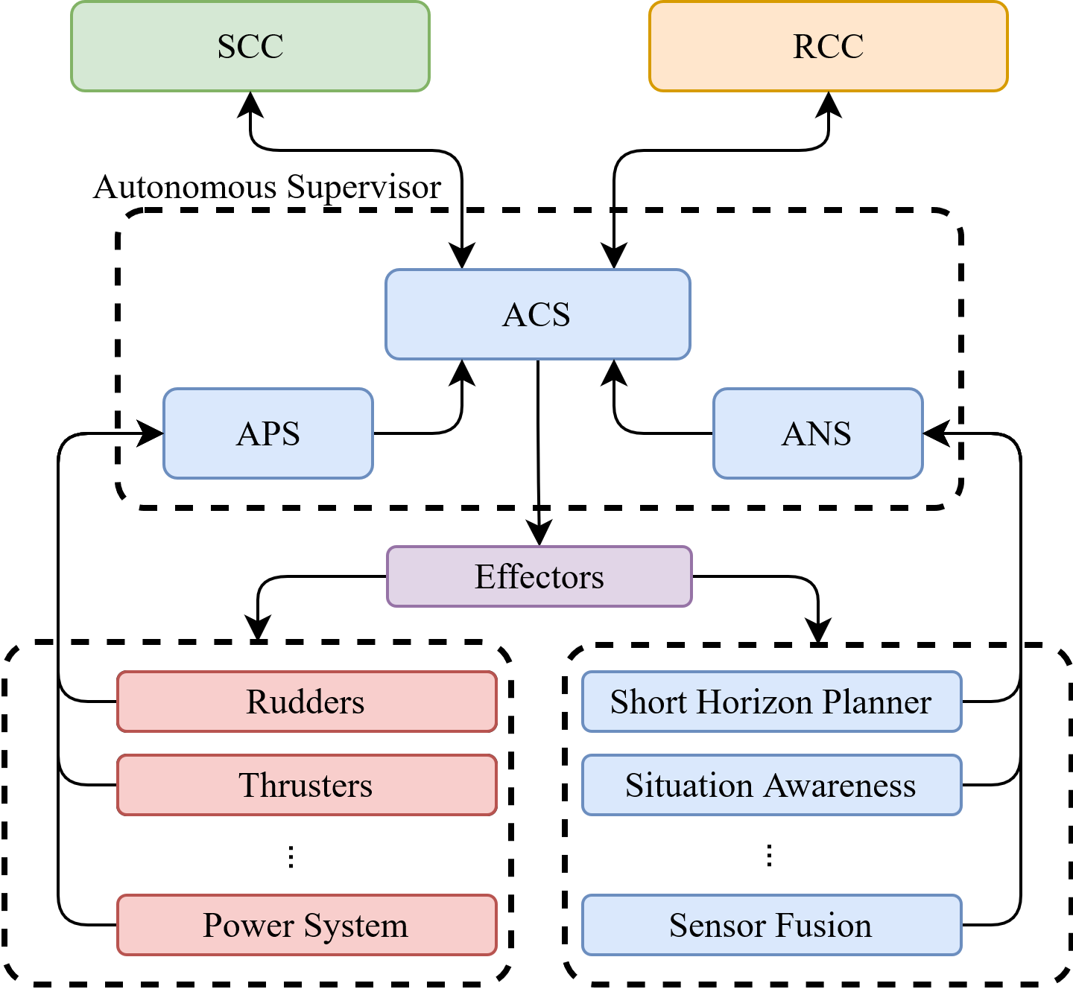
Project in Context
My project covers:
Autonomous Supervisor
Situation Awareness

Slide 3
What is "Temporarily unmanned bridge"?

Slide 4




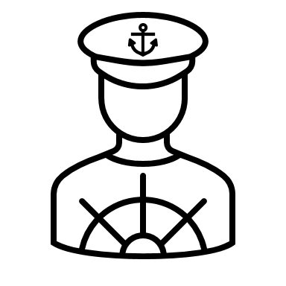

What is "Temporarily unmanned bridge"?
No unknowns = The system is in full control
Don't worry, I got this!
Alright buddy, sounds great!
Goes on to perform other duties

Slide 5
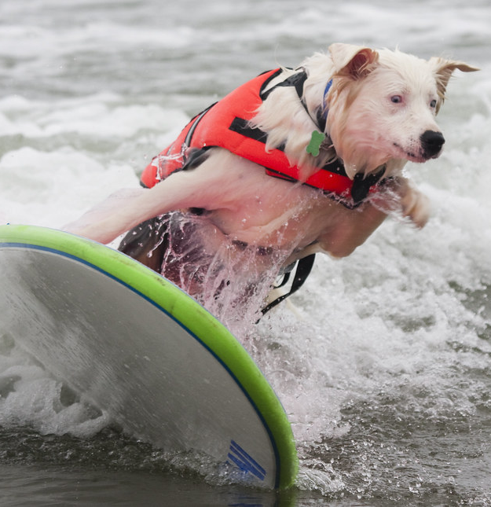
Out of nowhere, a surfing dog appears!
The system detects the “surfer dog“.
The system has never encountered such a thing and becomes uncertain.
The system requests help.

Slide 6


What is "Temporarily unmanned bridge"?
The system requests help from human
Let me have a look!
Oh no! I don't know what to do! Help!
It's just guido the surfer dog!
Sail around him
Goes to the SCC and inspects
6

Slide 7
What is the Goal?
We want to design a system that can:
Sail from point A to point B.
Navigate in a dynamical environment alongside humans (no special treatment).
Abide by the rules of the sea (COLREGs).
Handle complex situation in an uncertain environment.
Request help from a human proxy in case of unknowns.
In short: Our system needs to have situation awareness and act accordingly.
All of this must be achieved in a safe manner.

Slide 8
What is Situation Awareness?
"Situation awareness is the perception of the elements in the environment within a volume of time and space, the comprehension of their meaning, and the projection of their status in the near future."
- Mica R. Endsley¹
¹Endsley, Mica R. “Toward a theory of situation awareness in dynamic systems.” Human factors 37.1 (1995): 32-64.

Slide 9
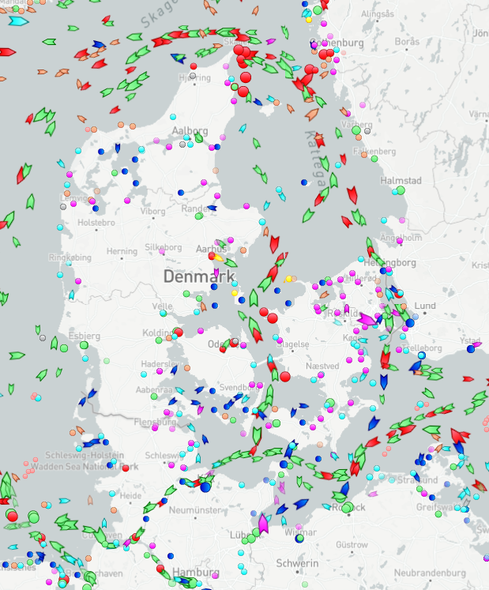
Situation Awareness at Sea
For all the vessels in the surrounding area,the navigator must:
Estimate speed, heading, draught and manoeuvrability.
Determine if a collision risk exists.
Evaluate the situation and apply the rules (COLREGs).
All while trying to maintain course, speed,avoid grounding etc.
Simple right?
Sometimes, yes.
Sometimes, not so much.
Marine traffic around Denmark on 20/11/2021. Screenshot from https://MarineTraffic.com​

Slide 10
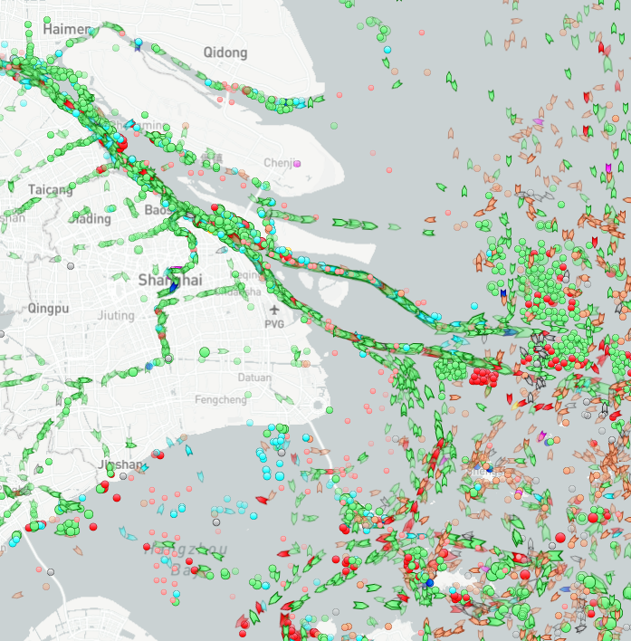
Situation Awareness at Sea
For all the vessels in the surrounding area,the navigator must:
Estimate speed, heading, draught and manoeuvrability.
Determine if a collision risk exists.
Evaluate the situation and apply the rules (COLREGs).
All while trying to maintain course, speed,avoid grounding etc.
Simple right?
Sometimes, yes.
Sometimes, not so much.
Marine traffic around Shanghai on 20/11/2021. Screenshot from https://MarineTraffic.com​

Slide 11
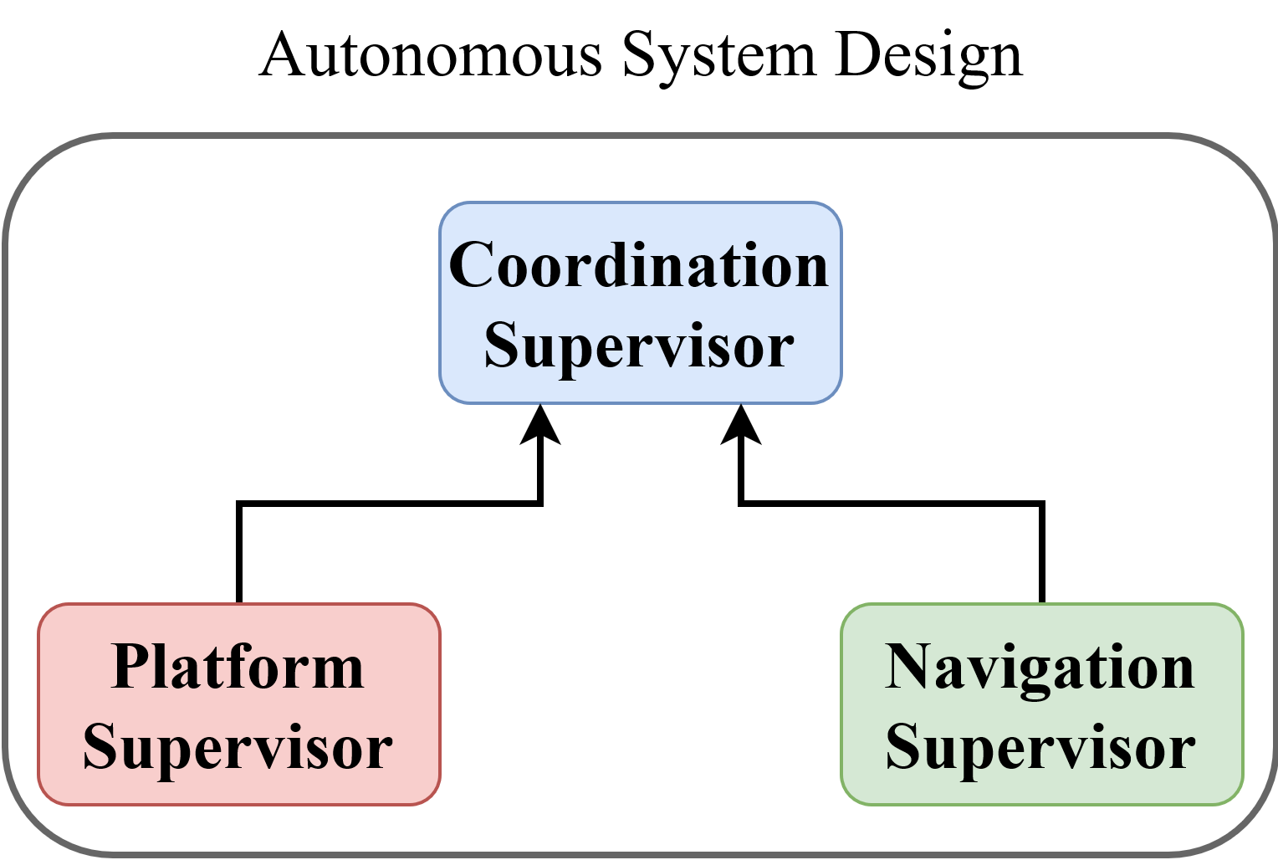
Supervisor Design
How to design for a complex system?
Divide & Conquer – Split into smaller more manageable parts
Split by Domain – engine control systems, navigation systems, communications systems, etc.
Get Inspiration – Take cues form current human implementation

Slide 12
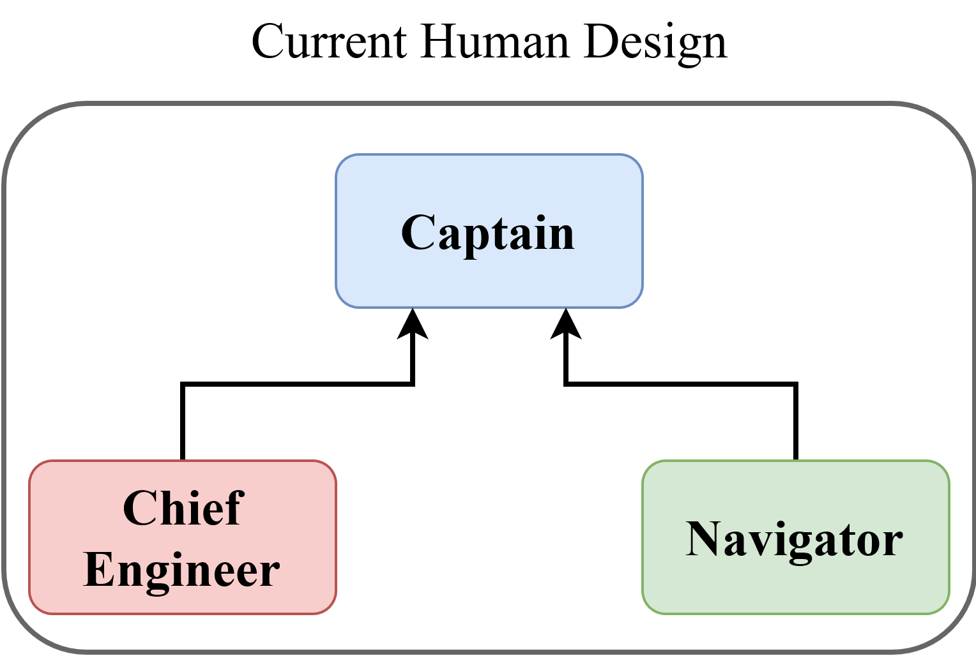
Supervisor Design
How to design for a complex system?
Divide & Conquer – Split into smaller more manageable parts
Split by Domain – engine control systems, navigation systems, communications systems, etc.
Get Inspiration – Take cues form current human implementation

Slide 13
Example Scenario: - Surfer Dog
Camera/Radar detects surfer dog
Sensor Fusion tries to classify but fails
Situation Awareness cannot apply COLREGs
ANS get notified about "unknown" object
ANS does not know how to navigate w.r.t. Unknown, forwards to ACS
ACS requests help from human proxy

Slide 14
What We Have Achieved
Design of a modular supervisor
Fits into current regulatory regime (STCW)
Responsibility of each sub-module is known by experts
A COLREGs-compliant framework for situation awareness
Based on Discrete Event Systems (DES)
Anticipation of future situations
A scheme for detection of anomalies
Trajectory classification using Autoencoders

Slide 15
Challenges Still Ahead
Unified representation of uncertainties (Boolean, categorical & continious).
Adaptive navigation objective, based on uncertainty and safety requirements.
How to integrate and learn from human expert.
Define and codify "Good Seamanship" (COLREGs rule 2).

Slide 16
Questions?

Slide 17
Thank you for listening!
Feel free to contact me at: pnha@elektro.dtu.dk

